Slide 1
ZONE DEFENSE
Andrew Fink

Slide 2
About Andrew Fink
Head Coach at University of St. Joseph (CT)
East Hartford, CT
Division III Lacrosse Program
2020 Inaugural Varsity Season
Great North Atlantic Conference

Slide 3
About Andrew Fink
Former Head Coach at Mount Ida College 2x Great North Atlantic Conference Champions
6x North Atlantic Conference Champions
4 NCAA Division III Tournament Appearances
2010 NCAA Statistical Champion: Man Down Defense - .907

Slide 4
Why Zone?
May 6, 2008 @ 4 p.m.

Slide 5
Why Zone
Up until 2008 man-to-man was the the only defense we played
When did this change?
May 6, 2008 at 4:00 p.m. in Newton, MA
May 7, 2008 vs. Bowdoin College
Why did this change?
Time was right to add a new dimension to our defense (no other choice)

Slide 6
All About The Zone
A solid zone defense can add a new dimension to your team defense
Compliment to man-to-man defense or can be a good substitute
Requires the right personnel and a commitment to work through the rough spots
Can be an effective strategy to take a way/limit an opponent’s strength or change the tempo of the game

Slide 7
All About The Zone
Find the right players for the job
Might not necessarily be the best man-to-man player
Attributes of a good zone player
Intelligent/high lacrosse I.Q.
Aggressive yet not too aggressive
Experienced and quick thinker
COMMUNICATION

Slide 8
Man Down Personnel
Find the right players for the job
Don’t let their “position” get in the way
Might even be your back-up goalie
Attributes of a good MDD player
Fast
Aggressive but controlled
Fearless
Experienced and quick thinker

Slide 9
Man Down Personnel
Attributes of a good MDD player (cont.)
Long
Good and quick hands
Good stick skills
Develop back-up players for your MDD unit

Slide 10
Brown Zone
Three Pole Front

Slide 11
Brown Zone
3 pole front zone
Cover/shutdown 3-3
Put pressure on shooters, on their hands
Outside/Perimeter
3 poles across the top
Pole on crease
Pole in middle and pole on crease work like pistons
“I” formation
Move up and down for coverage and support
Inside/Crease
Short sticks on bottom left and right
Hold at goal line extended (GLE), don’t press at “X”
Must be able to push and hold, no dunks!

Slide 12
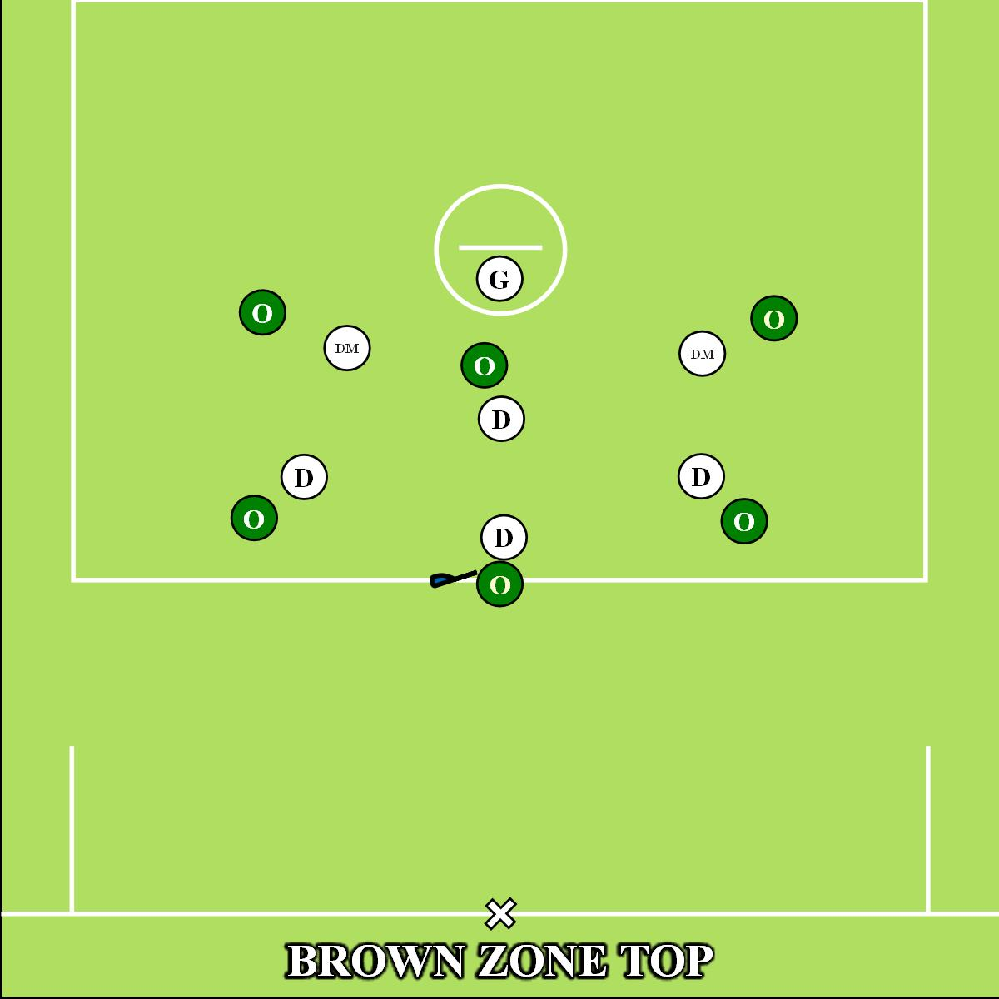

Slide 13
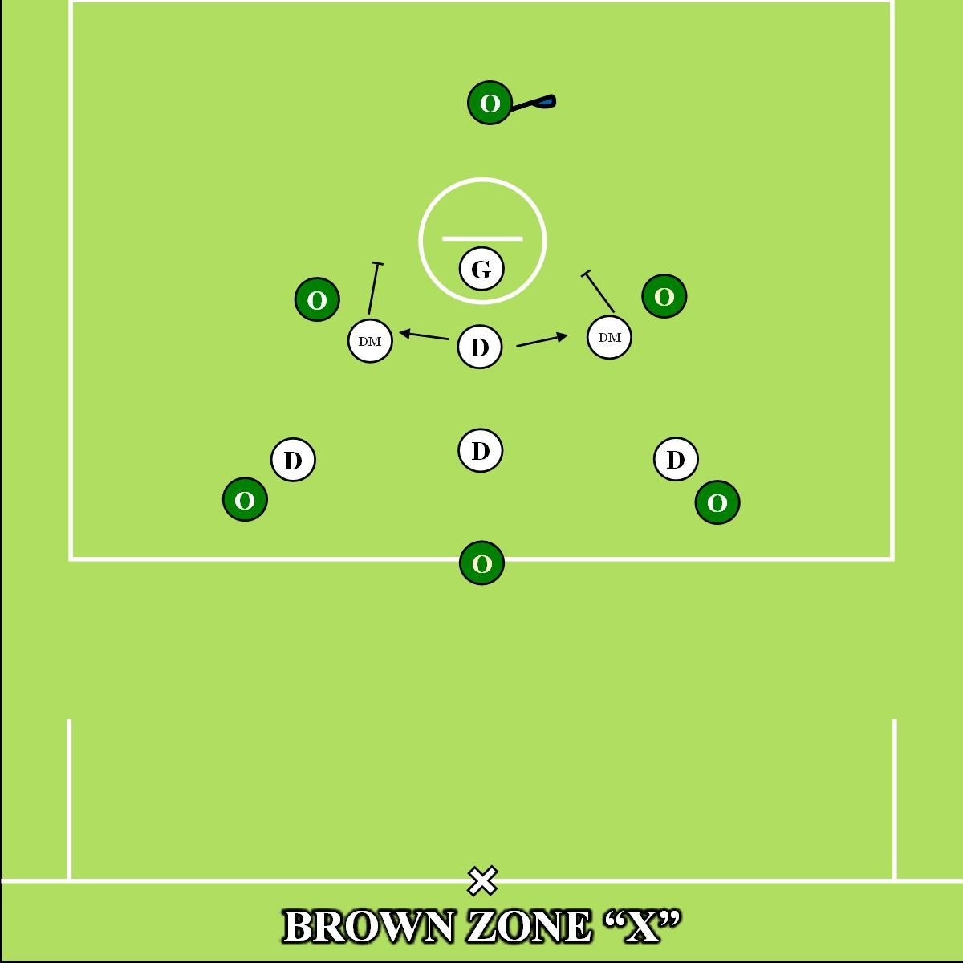

Slide 14
Brown Zone
Strength is ability to cover up top against shooting team
Get on their hands with the poles
Weakness are the short stick middies on the bottom
Need to be able to play body and not get beat inside at GLE
Big and strong middies and goalie that can hold pipe make this zone work

Slide 15
Contact Info
Andrew Fink, Head Coach University of St. Joseph (CT)
afink@usj.edu
(401) 965-9039
Instagram: Coachfinklax
Web: www.xcellax.com

Slide 16
We Want Your Feedback!
Download the LAXCON APP
Access the App Store on iOS devices or the Play Store on Android
Install the App: Search CrowdCompass AttendeeHub and Download.
Search the Attendee Hub App and enter “US Lacrosse Convention” and Download
Check-in to this session and complete the session survey!

