Slide 1
Defense Using Your Hands
Andrew Fink, Head Coach Anthony DiMaio, Associate Head Coach Chris Widelo, Special Assistant
Mount Ida College

Slide 2
Located in Newton, MA. 5 miles outside of Boston.
Division III Lacrosse Program
6x North Atlantic Conference Champions
2x Great Northeast Athletic Conference Champions
4 NCAA tournament appearances
2010 NCAA Statistical Champion: Man Down Defense - .907

Slide 3
5th Year Presenting at US Lacrosse Convention
2009 – Offense/Defense: Strategy and Adjustments
2010 – Team Defense
2011 – Zone Defense
2012 – Man Down Defense
2015 – Defense Using Your Hands
Past presentations available at XCELLacrosse.com

Slide 4
Foundations of Sound Defense
Fundamentals!
Positioning and using your feet, no lunging
Controlled, strategic, well timed checks
Controlling ball carrier and not taking the ball away
Playing the angles, containment of offensive player
Defender keeps stick up field

Slide 5
The “Ida Way” Defense
Do not create mistakes or give the advantage to the offense
Players can throw three check
Lift Check (no riding the hip)
Poke and cross-poke
Slap downs

Slide 6
The “Ida Way” Defense
Banned list of checks
Wrap checks
Back wraps
Over the head
Kayaks and other fancy checks
Quick way to find yourself on the bench is to throw one of the banned checks

Slide 8
The Game Has Changed
Era of physical play and the body check are over
Officials are cracking down on physical play
Safety is paramount
Advantage goes to offense and attacking player
No threat of a hard slide or physical body check

Slide 9
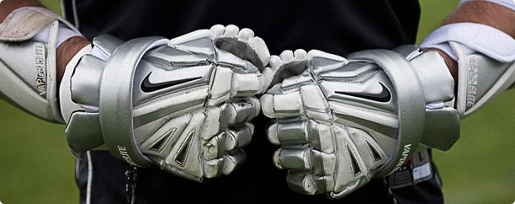

Slide 10
Hands Are Defensive Weapons
Put your expensive gloves to use!
Create space between you and your opponent
Control the ball carrier
Set up well placed check
Establish physical presence on the field legaly

Slide 11
GLE
GLE
Alley
Hot Spot
Alley

Slide 12
Top Hand Pop
Disrupting ball carrier’s movement
Creating space as offensive player tries to close the gap with defender
Setup dropping check on hands or slap check, cross-poke
Establish physical presence

Slide 13
GLE
GLE
Alley
Alley
O
D
D
O

Slide 14
Bottom Hand Pop
Used to combat roll dodge, rocker step and swim move.
Doesn’t let offensive player get inside defender
Maintain separation
Alternative to a back-wrap
Buys time for you to regroup and get stick in position

Slide 15
Back Blow
1 on 1 Defense vs. dodging player
Use bottom hand as part of physical play in combination with stick checks
Set up stick checks
Aggressive defense, put the ball on the ground

Slide 16
Forearm Pop/”V” Hold
Useful when opponent is driving topside toward defender’s “weak side” or bottom hand
Positions stick up-field
Forearm is used to engage ball carrier and walk them out into an alley or below GLE

Slide 17
Forearm Pop/”V” Hold
Counter to “bull dodge”
Useful when opponent is driving topside toward defender’s “weak side” or bottom hand
Positions stick up-field
Forearm is used to engage ball carrier and walk them out into an alley or below GLE

Slide 18
GLE
GLE
Alley
Hot Spot
Alley

Slide 19
O
O
O
D
GLE
D
GLE
D
Alley
Alley

Slide 20
5:30pm - 6:30pm
Room: 314-317
Character
John Danowski, Duke University

Slide 21
Questions?
Andrew Fink, Head Coach Mount Ida College
AEFink@mountida.edu / (617) 928-4731
www.xcellacrosse.com

Slide 22
5:30pm - 6:30pm
Room: 314-317
Character
John Danowski, Duke University

