Slide 1
Zone Defense
Andrew Fink – Head Coach, Mount Ida College Anthony DiMaio – Associate Head Coach, Mount Ida College
US Lacrosse Convention January 23, 2016 | Baltimore, MD

Slide 2
Located in Newton, MA. 5 miles outside of Boston.
Division III Lacrosse Program
6x North Atlantic Conference Champions
2x Great Northeast Athletic Conference Champions
4 NCAA tournament appearances
2010 NCAA Statistical Champion: Man Down Defense - .907

Slide 3
6th Year Presenting at US Lacrosse Convention
2009 – Offense/Defense: Strategy and Adjustments
2010 – Team Defense
2011 – Zone Defense
2012 – Man Down Defense
2015 – Defense Using Your Hands 2016 – Defensive Angles | Zone Defense
Download presentations at www.xcellax.com/uslacrosse

Slide 4
Mount Ida College
Up until 2008 we played a man-to-man defense
When did this change?
May 6, 2008 at 4:00 p.m. in Newton, MA
Why did this change?
Time was right to add a new dimension to our defense (no other choice)

Slide 5
Why Zone Defense
A solid zone defense can add a new dimension to your team defense
Compliment to man-to-man defense or can be a good substitute
Requires the right personnel and a commitment to work through the rough spots
Can be an effective strategy to take a way/limit an opponent’s strength or change the tempo of the game

Slide 6
Zone Defense Personnel
Find the right players for the job
Might not necessarily be the best man-to-man player
Attributes of a good zone player
Intelligent/high lacrosse I.Q.
Aggressive yet not too aggressive
Experienced and quick thinker
COMMUNICATION

Slide 7
Green Zone
“Box and 2” Zone
Cover 1-4-1, 1-3-2, 2-2-2
Outside/Perimeter
Poles on the outside/perimeter
Set up in a Box or Diamond
Man-down rotation on perimeter
Poles can cover motion offense dodging alleys
Easy to pass-off and hold spot in rotation
Inside/Crease
Short sticks inside
Always have support/coverage on crease
Play “book ends,” left or right side

Slide 8
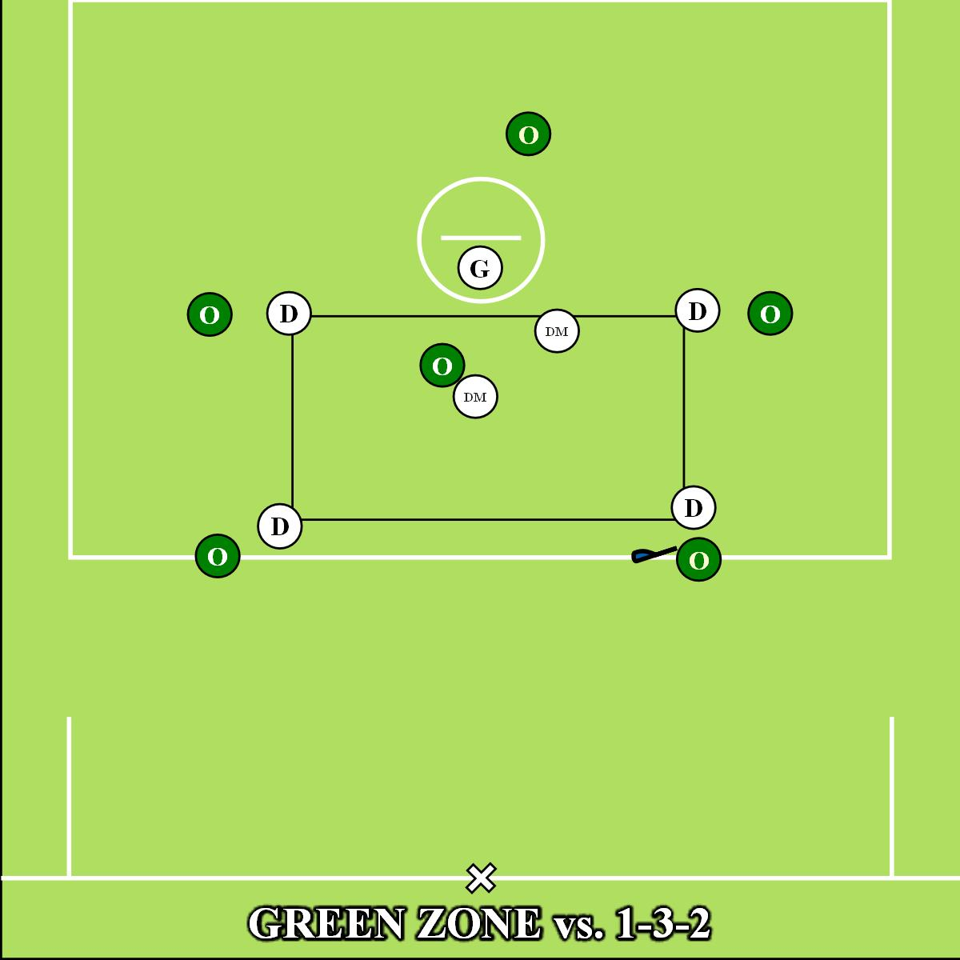
Notes:
Stick not up field

Slide 9
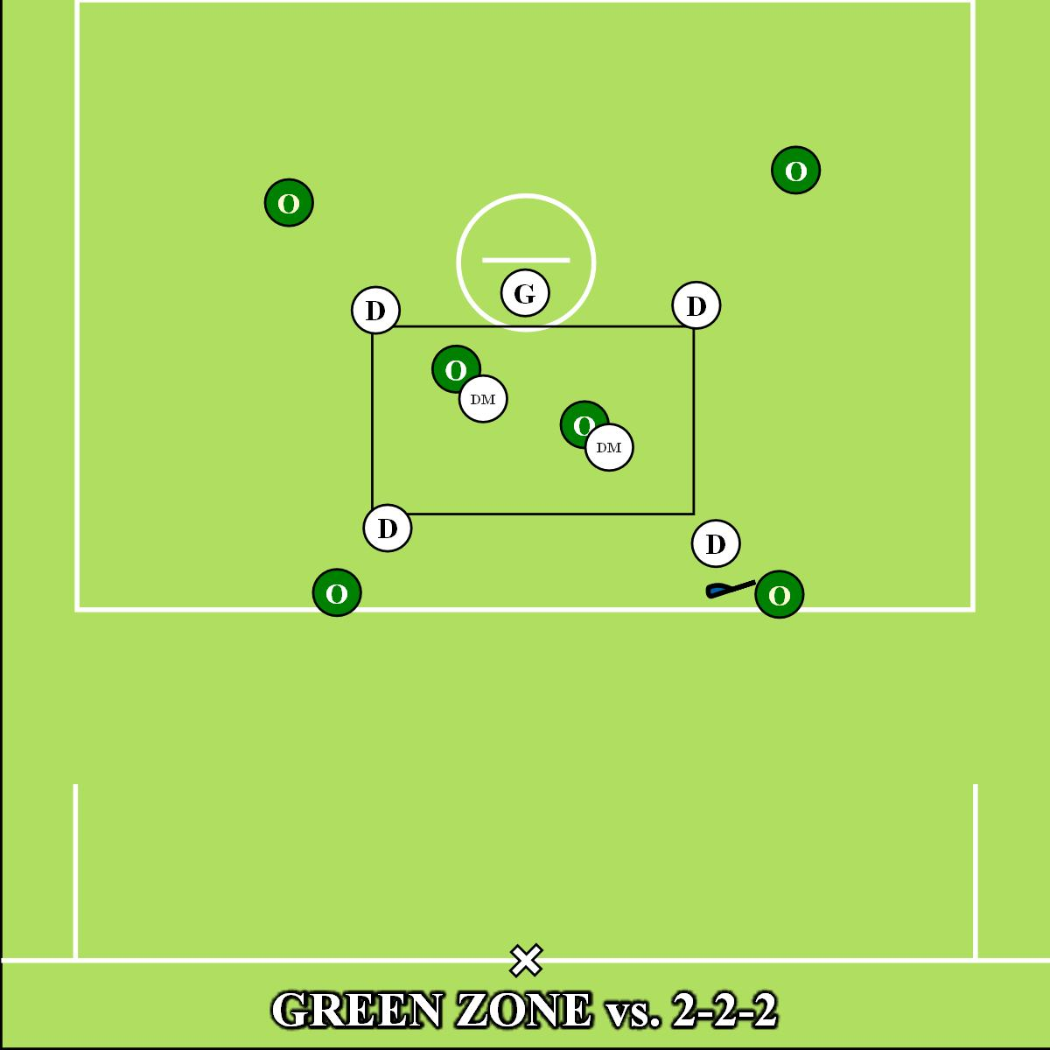
Notes:
Stick not up field

Slide 10
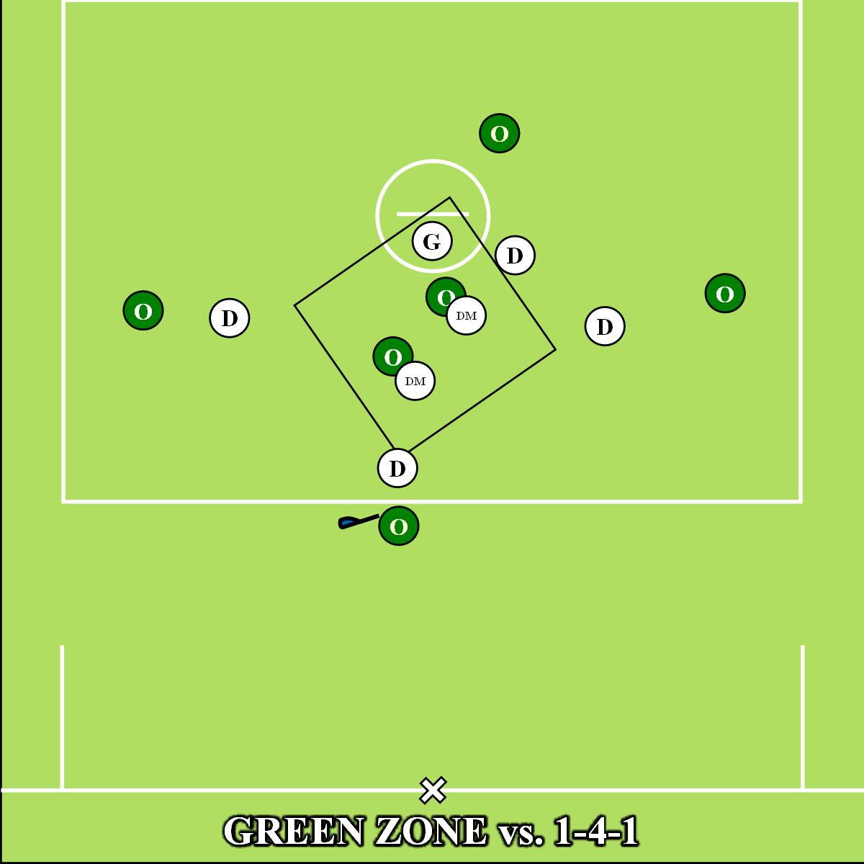
Notes:
Stick not up field

Slide 11
Strength of zone is simplicity, similar to man-down defense and very versatile
Weakness is its simplicity and it is used by many teams
Players need to communicate and middies on crease need to work hard and stay with their man

Slide 12
Brown Zone
3 pole front zone
Cover/shutdown 3-3
Put pressure on shooters, on their hands
Outside/Perimeter
3 poles across the top
Pole on crease
Pole in middle and pole on crease work like pistons
“I” formation
Move up and down for coverage and support
Inside/Crease
Short sticks on bottom left and right
Hold at goal line extended (GLE), don’t press at “X”
Must be able to push and hold, no dunks!

Slide 13
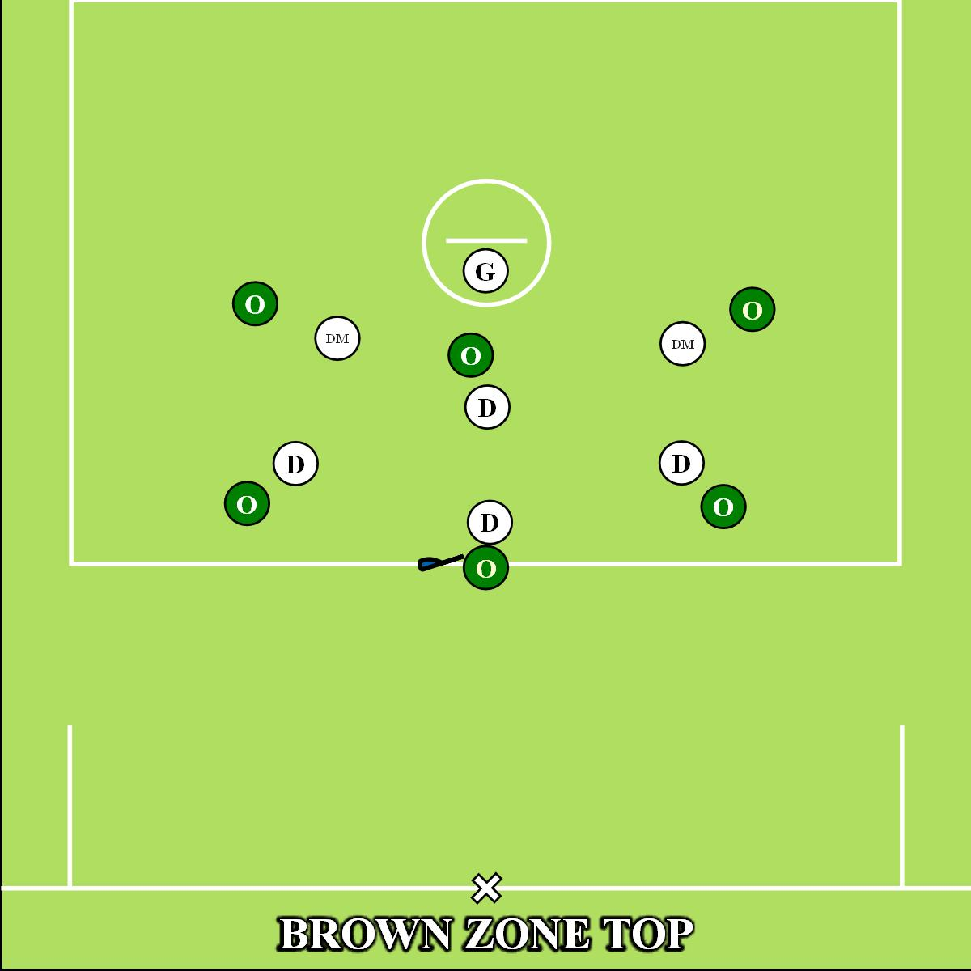

Slide 14
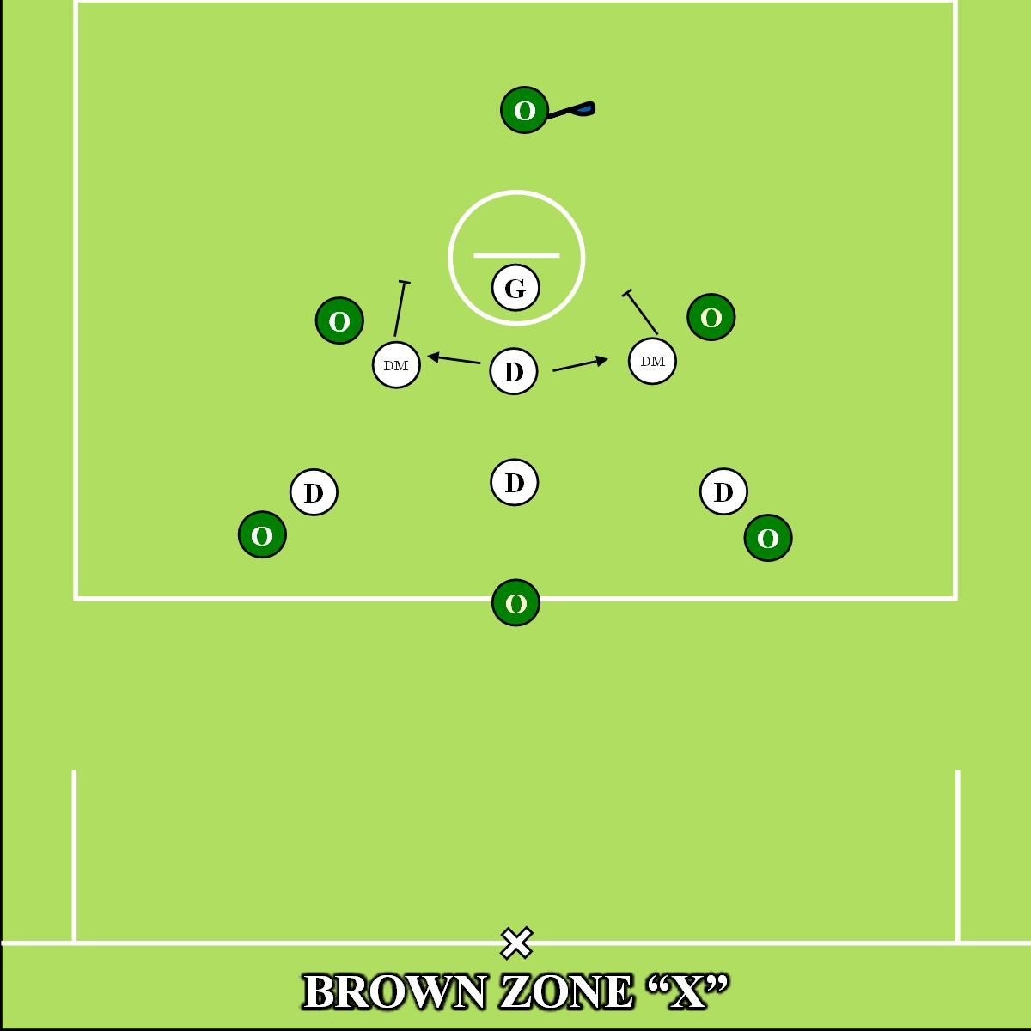

Slide 15
Strength is ability to cover up top against shooting team
Get on their hands with the poles
Weakness are the short stick middies on the bottom
Need to be able to play body and not get beat inside at GLE
Big and strong middies and goalie that can hold pipe make this zone work

Slide 16
White Zone
Aggressive zone
Versatile against multiple offenses
Effective against an inverted offense
Virginia won a National Championship with this zone
Outside/Perimeter
Short stick middies up top, must push/play body
Two poles on the bottom/GLE
Inside/Crease
Poles in the middle are in an “I” formation
LSM slide hard and recover, look for double

Slide 17
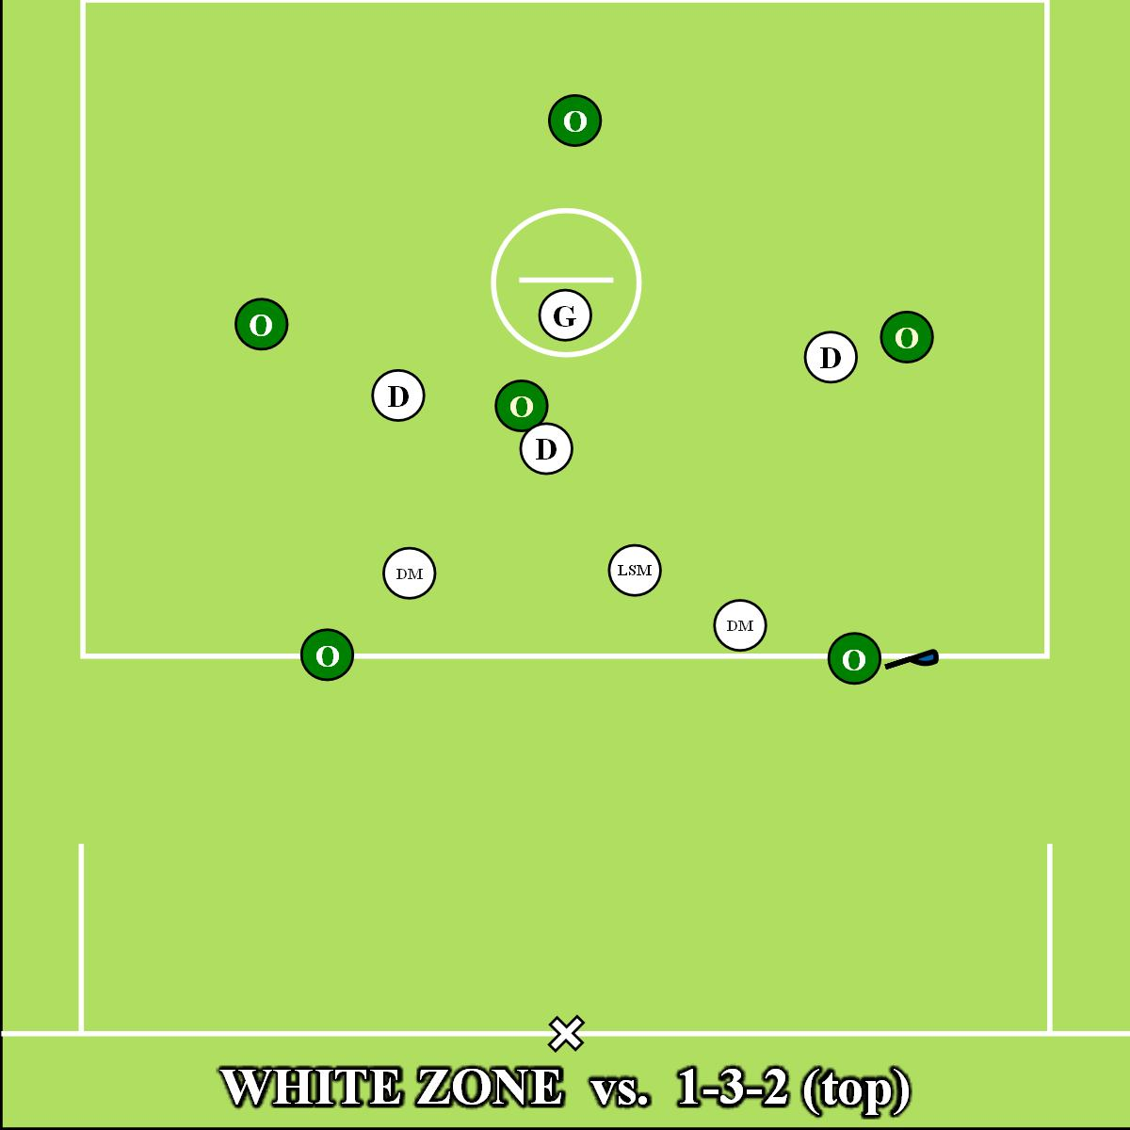
Notes:
Proper v-hold, forearm bump

Slide 18
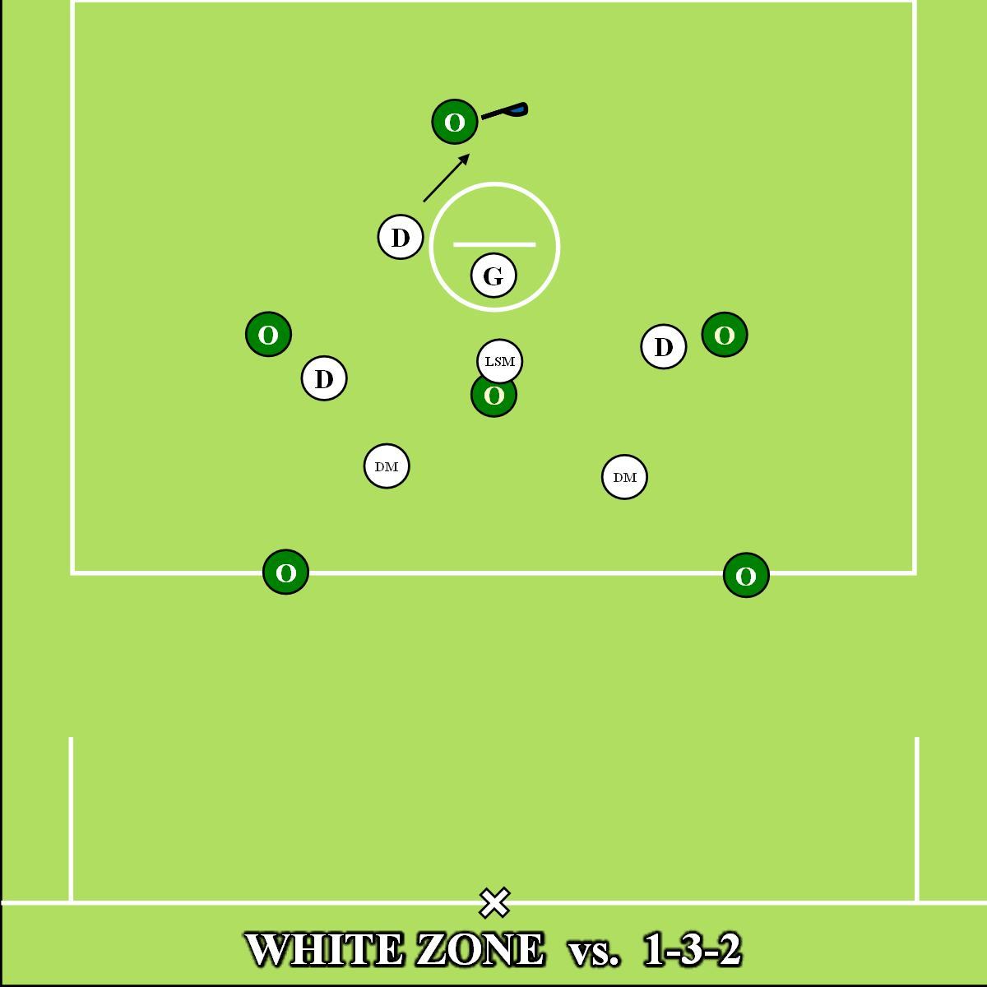
Notes:
Proper v-hold, forearm bump

Slide 19
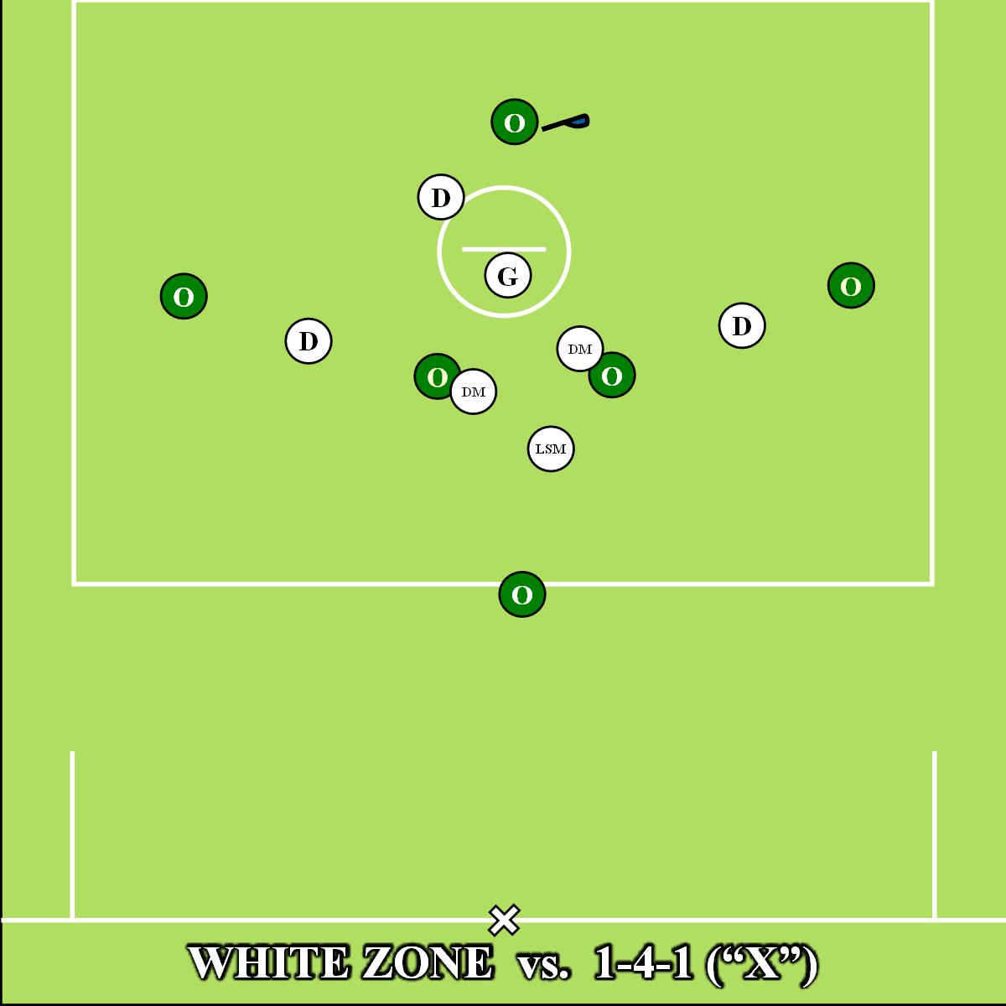
Notes:
Proper v-hold, forearm bump

Slide 20
Strength is ability to cover crease and “X” with poles
Slide fast off crease with poles to double
Weakness is the alley dodge and topside support
Need to be able to play body and not get beat inside at GLE
Experienced and athletic defense and a bit time goalie that makes big saves

Slide 21
THANK YOU!
Andrew Fink | aefink@mountida.edu
Anthony DiMaio | adimaio@mountida.edu
www.xcellax.com/uslacrosse

